Slide 1


Portfolio Management System (PortfolioBox)
Developed By
SAGAR PIPALIYA 19MCA028
NIKUNJ KATARIYA 19MCA010
Guided By
ASST. PROF. RUSHABH SHAH

Slide 2

Project Profile
Project Definition
Project Profile
Tools and Technologies
Proposed System
Objectives
Users of the system
UML Diagram
Use case Diagram
Activity Diagram
Sequence Diagram
State Chart Diagram
Class Diagram
Database Design
Data Dictionary
Bibliography.

Slide 3
Project Definition
Portfolio Management system refers to a building a strong resume for the candidate who are seeking the jobs online.
This system introduced the way of hiring the employees for the organization that contains all the information of the employees and according to their skill and job requirements, they get selected in the particular post.
The purpose of Portfolio management is the selection, prioritization and control of an organization's programmed and projects, in line with its strategic objectives and capacity to deliver.

Slide 4
Project Profile
Project Information | Description
Project Title | Portfolio Management System
Application Type | Web Application
Guided By | Asst. Prof. Rushabh Shah
Group Size | 2
Team Members | Pipaliya Sagar M. (19MCA028) Katariya Nikunj N. (19MCA010)

Slide 5
Tools and Technologies
Tools and Technology | Description
Front End | PHP (7.2)
Back End | MySQL (8.0)
Web Server | Apache XAMPP
Other tools | Microsoft World (2016) Microsoft PowerPoint (2016) Sublime text 3 (3.2.2) Creatly (for the diagrams)

Slide 6
Proposed System
This website provides online resume building with an effective design for the job seekers who doesn’t know how to build a professional resume for the organizations.
Users have provide their personal details for generating effective and strong resume for the organization.
Time saving and user friendly.

Slide 7
Objectives
Candidates may open the website 24*7 and they can generate their desired resume building options.
Basic registrations are their to login in the system for security, because the resume will only edited by the candidate not by the third party.

Slide 8
Users of the system
Admin
Candidates
Visitors

Slide 9
Scope of Admin
View all the details
Manage Candidates
Manage Blocking list
Generate Report
Search/Filter Candidates

Slide 10
Scope of User
View Details
Modify Details
Add new Details

Slide 11
UML Diagrams
Use-Case Diagram
Activity Diagram
Sequence Diagram
State Chart Diagram
Class Diagram

Slide 12
1. Use-Case Diagram
Admin
User

Slide 13
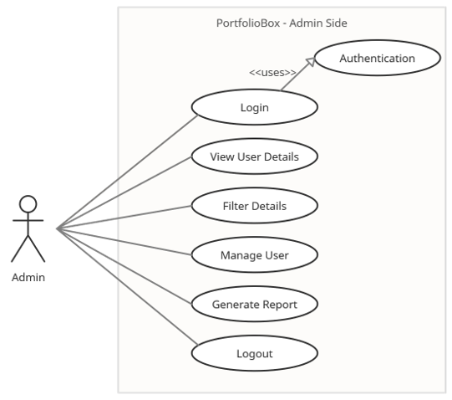
1. Use-Case Diagram
(Admin)

Slide 14
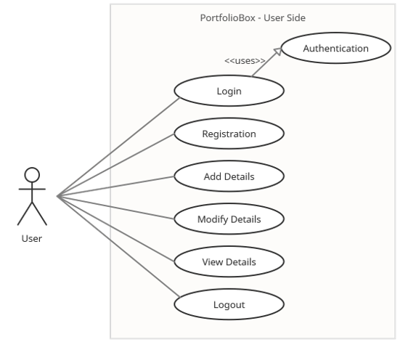
1. Use-Case Diagram
(User)

Slide 15
2. Activity Diagram
Admin
User

Slide 16
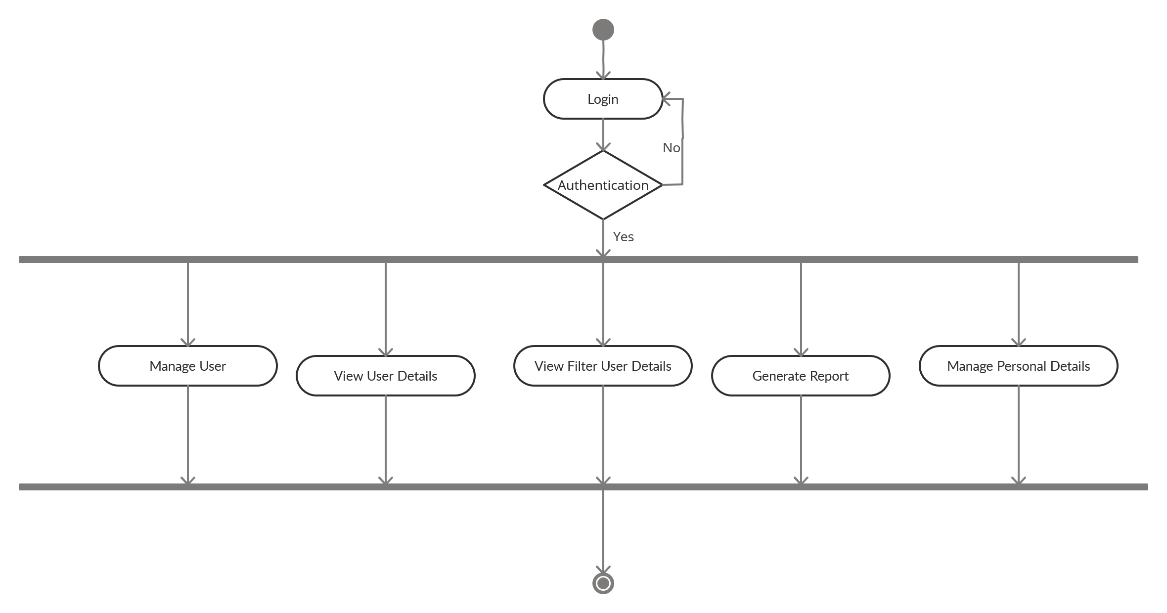
2. Activity Diagram
(Admin)

Slide 17
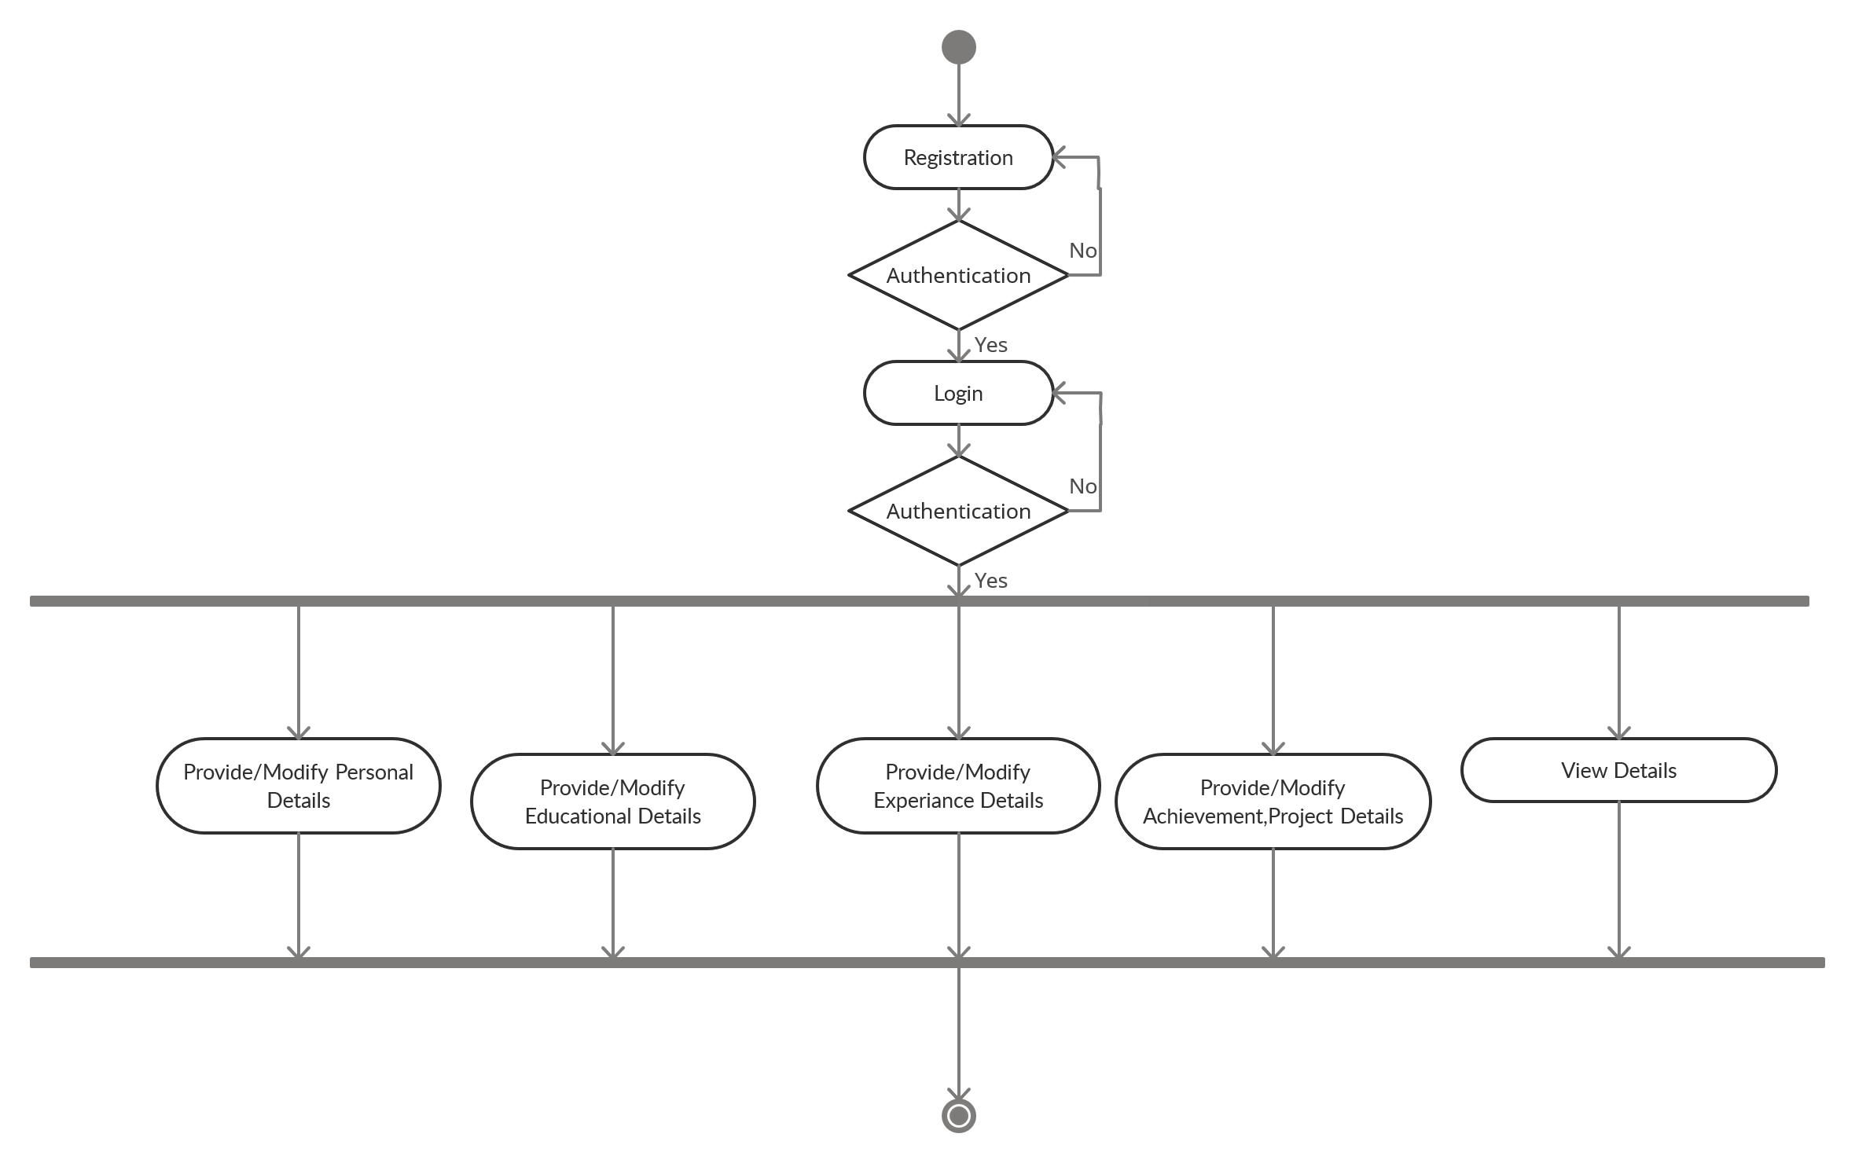
2. Activity Diagram
(User)

Slide 18
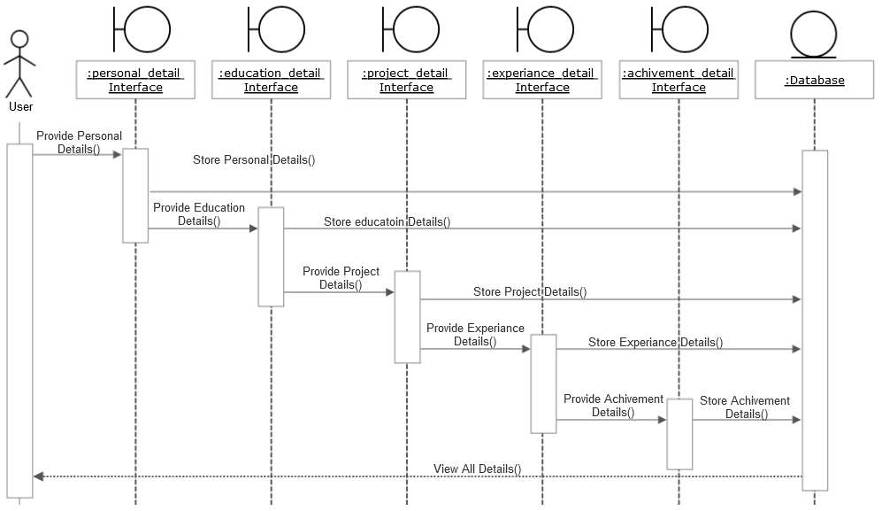
3. Sequence Diagram
(User)

Slide 19
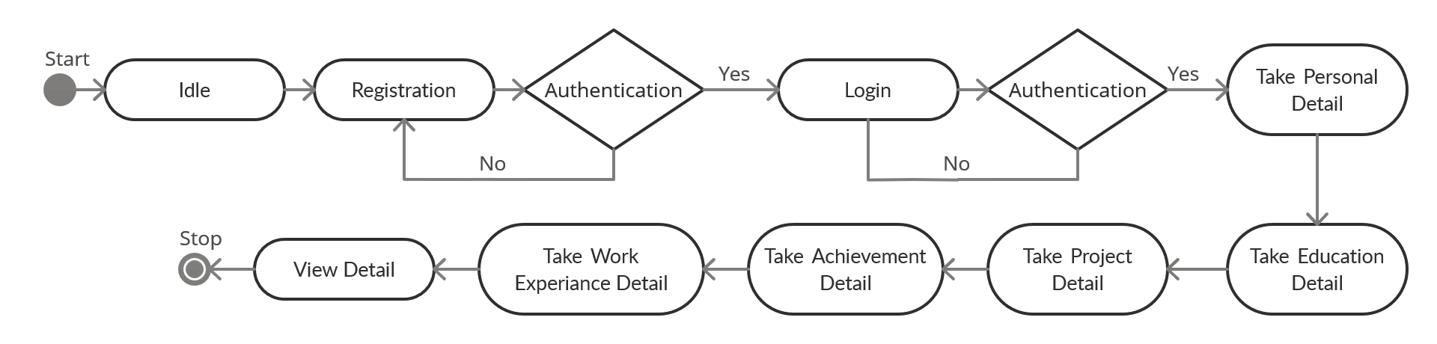
4. State Chart Diagram
(User)

Slide 20
5. Class Diagram

Slide 21
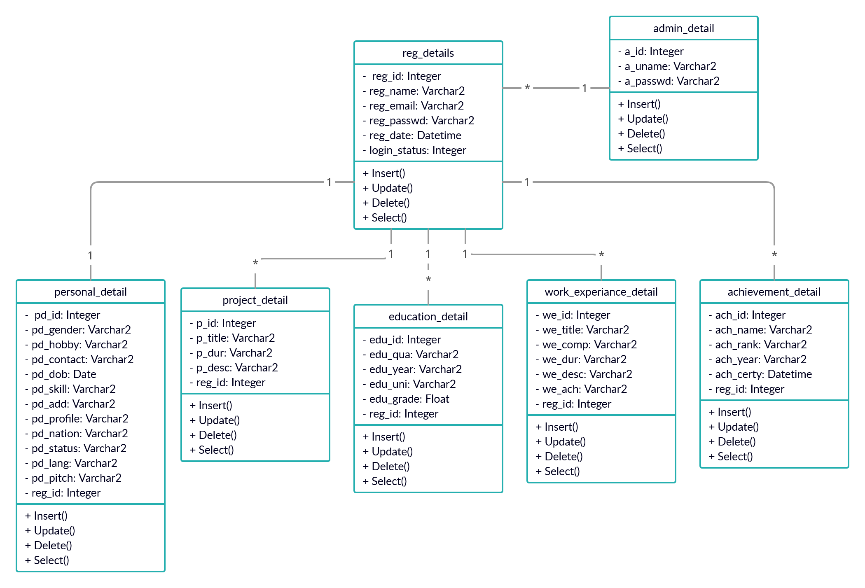
5. Class Diagram

Slide 22
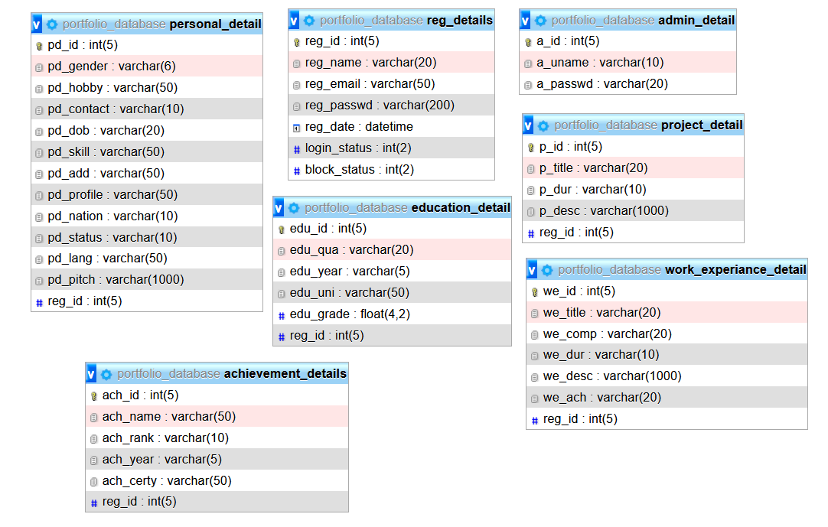
Database Design

Slide 23
Data Dictionary

Slide 24
Data Dictionary (reg_details)
SR NO | Columns | Data Type | Size | Null | Description
1. | reg_id | Integer | 5 | No | Primary key
2. | reg_name | Varchar2 | 20 | No | Name of user
3. | reg_email | Varchar2 | 20 | No | Email of user
4. | reg_passwd | Varchar2 | 20 | No | Password set by the user
5. | reg_date | Datetime |  | No | Registration Date of User
6. | login_status | Integer | 2 | No | Login Status
7. | block_status | Integer | 2 | No | User blocking status

Slide 25
Data Dictionary (personal_detail)
SR NO | Columns | Data Type | Size | Null | Description
1. | pd_id | Integer | 5 | No | Primary key
2. | pd_gender | Varchar2 | 2 | No | Gender of user
3. | pd_hobby | Varchar2 | 50 | No | Hobbies of user
4. | pd_contact | Varchar2 | 10 | No | Contact detail of a user
5. | pd_dob | Date | - | No | Birthdate of user
6. | pd_skill | Varchar2 | 50 | No | Technical skills of user
7. | pd_add | Varchar2 | 50 | No | Address of a user
8. | pd_profile | Varchar2 | 50 | No | Profile photo of user
9. | pd_nation | Varchar2 | 10 | No | Nationality of user
10. | pd_status | Varchar2 | 10 | No | Marital status of user
11. | pd_lang | Varchar2 | 50 | No | Languages known
12. | pd_pitch | Varchar2 | 50 | No | Short pitch about user
13. | reg_id | Integer | 5 | No | Reference from reg_detail

Slide 26
Data Dictionary (admin_details)
SR NO | Columns | Data Type | Size | Null | Description
1. | a_id | Integer | 5 | No | Primary key
2. | a_uname | Varchar2 | 10 | No | Username of admin
3. | a_passwd | Varchar2 | 20 | No | Password of admin

Slide 27
Data Dictionary (education_details)
SR NO | Columns | Data Type | Size | Null | Description
1. | edu_id | Integer | 5 | No | Primary key
2. | edu_qua | Varchar2 | 20 | No | Qualification details
3. | edu_year | Varchar2 | 5 | No | Passing year
4. | edu_uni | Varchar2 | 50 | No | Name of School/University
5. | edu_grade | Float | 4,2 | No | Grade of user
6. | reg_id | Integer | 5 | No | Reference from reg_detail

Slide 28
Data Dictionary (project_details)
SR NO | Columns | Data Type | Size | Null | Description
1. | p_id | Integer | 5 | No | Primary key
2. | P_title | Varchar2 | 20 | No | Title of a project
3. | p_dur | Varchar2 | 10 | No | Project duration
4. | p_desc | Varchar2 | 50 | No | Project description
5. | reg_id | Integer | 5 | No | Reference from reg_detail

Slide 29
Data Dictionary (achievement_details)
SR NO | Columns | Data Type | Size | Null | Description
1. | ach_id | Integer | 5 | No | Primary key
2. | ach_name | Varchar2 | 50 | No | Name of Achievement
3. | ach_rank | Varchar2 | 10 | No | Rank of user achievement
4. | ach_year | Varchar2 | 5 | No | Year of achievement
5. | ach_certy | Varchar2 | 50 | No | Certification of user
6. | reg_id | Integer | 5 | No | Reference from reg_detail

Slide 30
Data Dictionary (work_experiance_detail)
SR NO | Columns | Data Type | Size | Null | Description
1. | we_id | Integer | 5 | No | Primary key
2. | we_title | Varchar2 | 20 | No | Position of user
3. | we_comp | Varchar2 | 20 | No | Name of the company
4. | we_dur | Varchar2 | 10 | No | Working duration
5. | we_desc | Varchar2 | 50 | Yes | Company profile
6. | we_ach | Varchar2 | 20 | Yes | Achievement of a user
7. | reg_id | Integer | 5 | No | Reference from reg_detail

Slide 31
Bibliography
CV Maker :- https://www.cvmaker.com
Resume Builder :- https://resumebuild.com/

Slide 32
Thank You!

